Slide 1
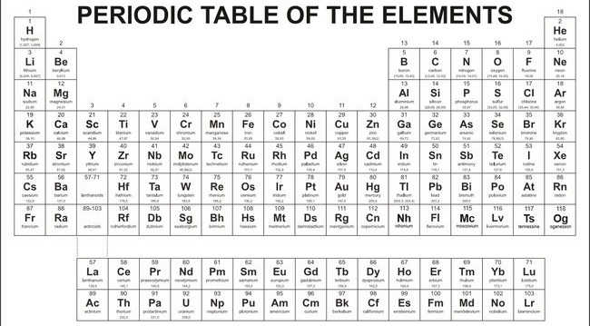
Week 1
Describe where metals & nonmetals appear in the Periodic Table, and name the kinds of elements that combine to make covalent molecules and salts

Slide 2

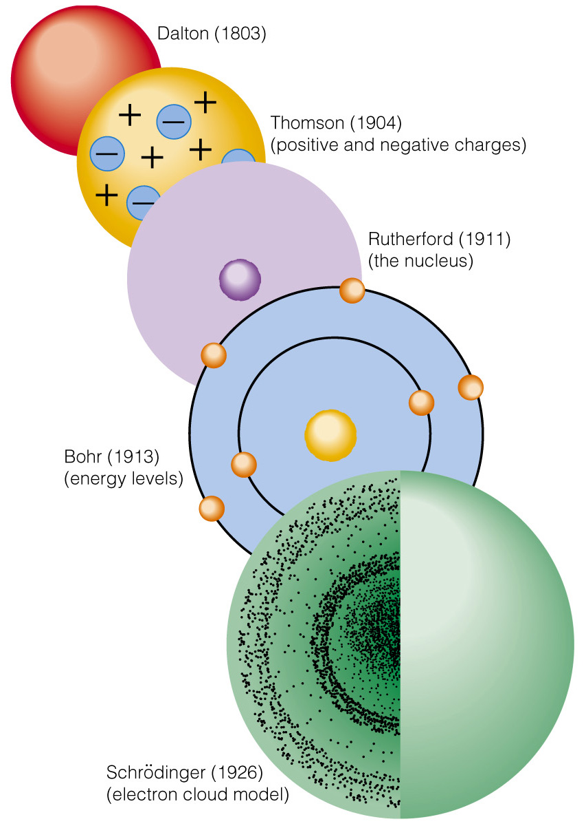
Week 1
Identify which of these is Rutherford’s view of atoms, and explain the main features

Slide 3
Week 1
Identify which of these is Schrödinger’s modification of Rutherford’s view, and explain the main differences

Slide 4
Week 1
State the number of protons, neutrons, and electrons for an oxygen atom having zero net charge and a mass number of 18

Slide 5
Week 2
Sketch how the temperature of the atmosphere changes as you go up in a balloon through the troposphere and stratosphere.
50
Altitude above Earth’s surface (km)
0
Temperature

Slide 6
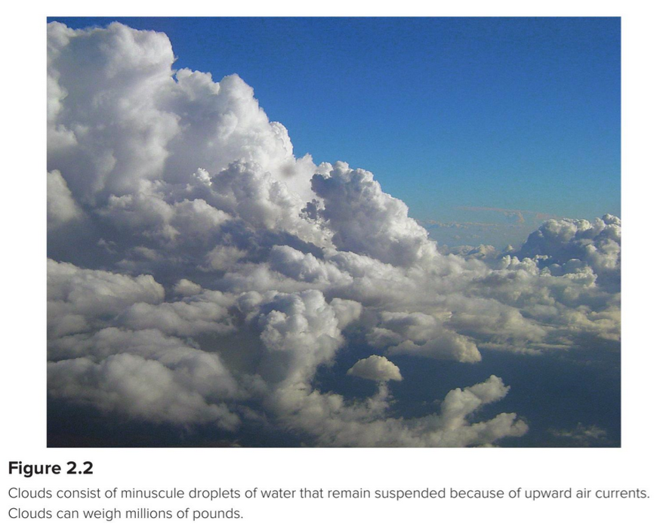
Week 2
Name the top two most abundant gases in Earth's atmosphere, and their approximate percentages

Slide 7
Week 2
The concentration of argon in air is approximately 0.93%. Converting to ppm, this would be ...

Slide 8
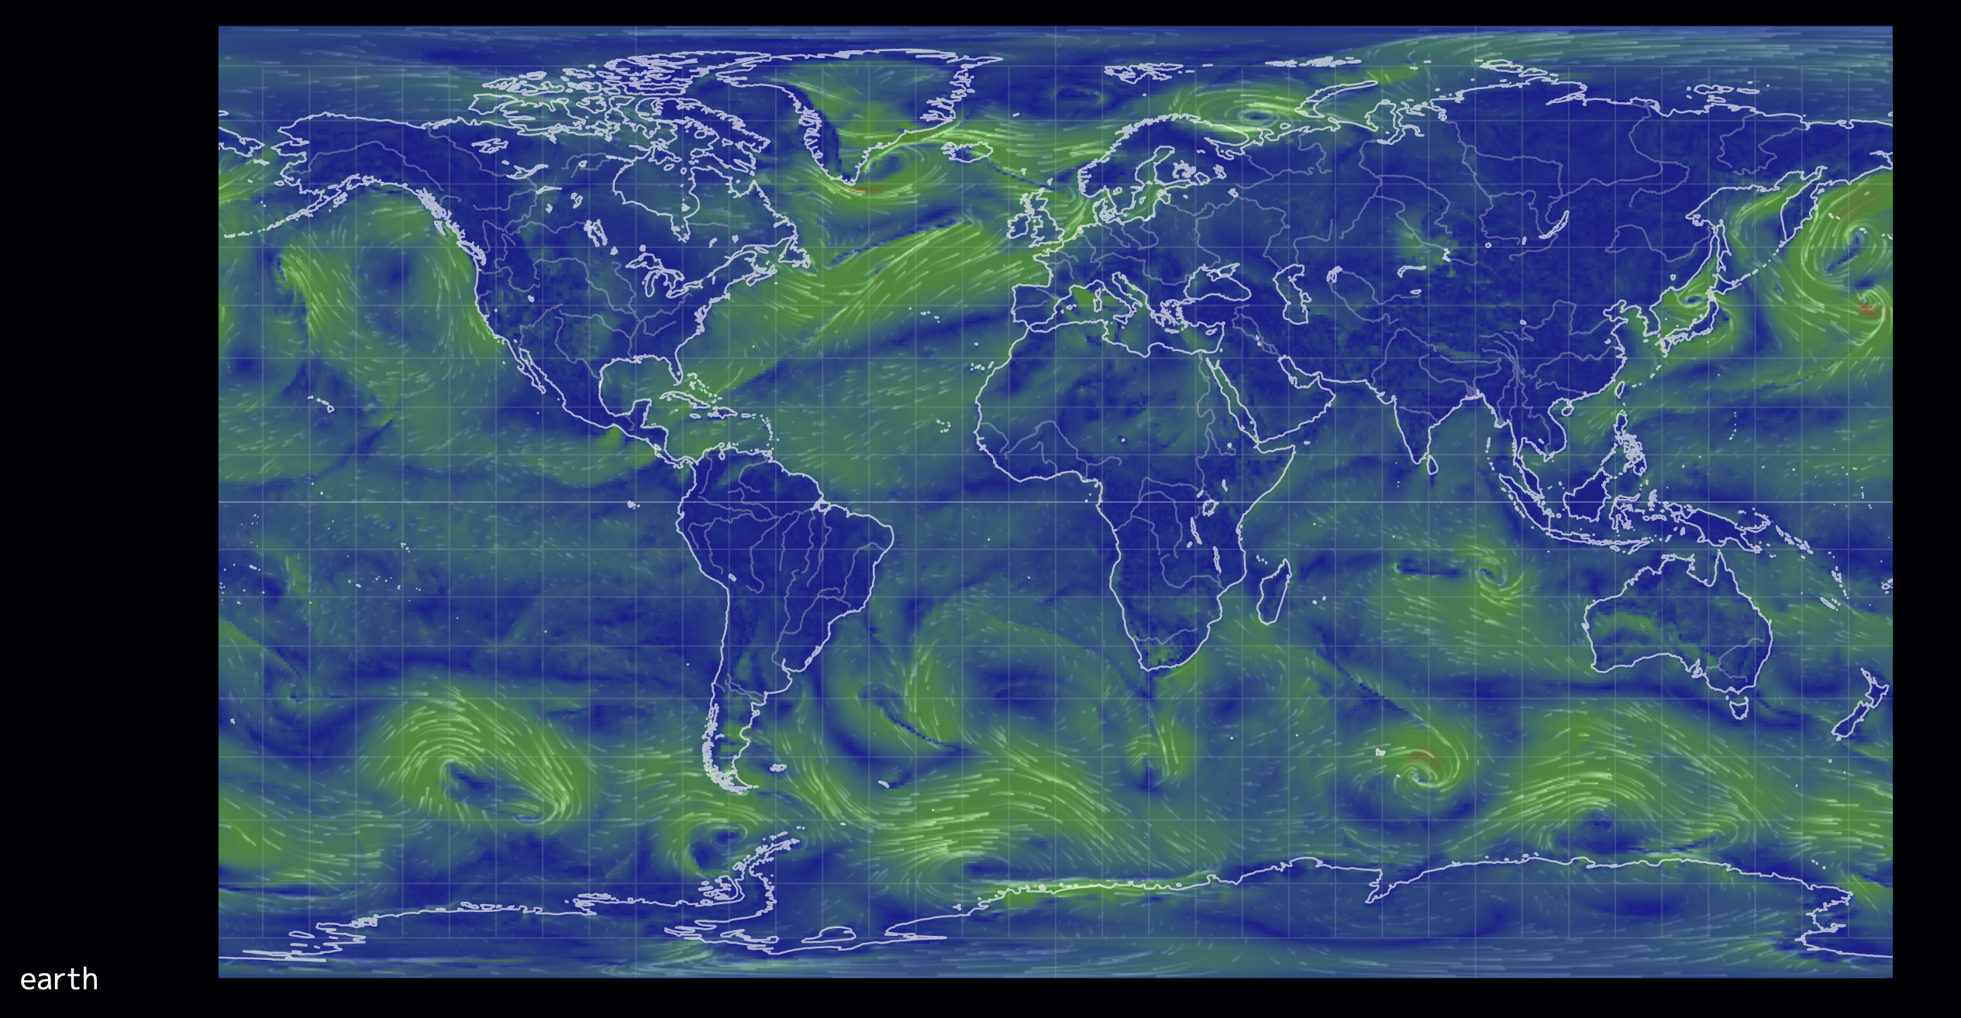
Week 2
Indicate a region of Earth where you’d expect lower-than-average concentrations of CO₂, and another region where you’d expect greater-than-average concentrations

Slide 9
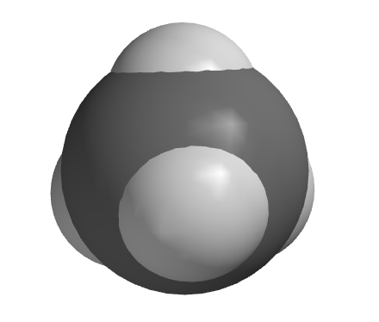
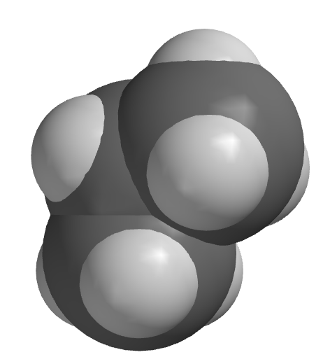
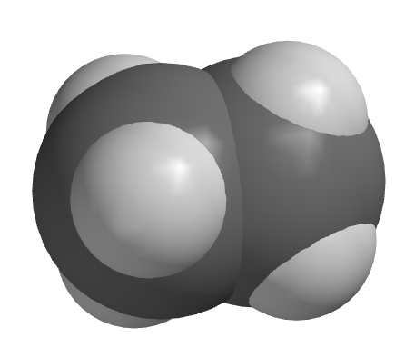
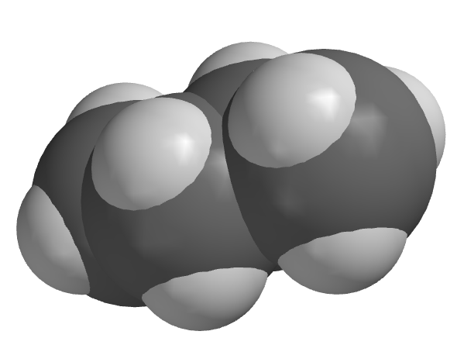
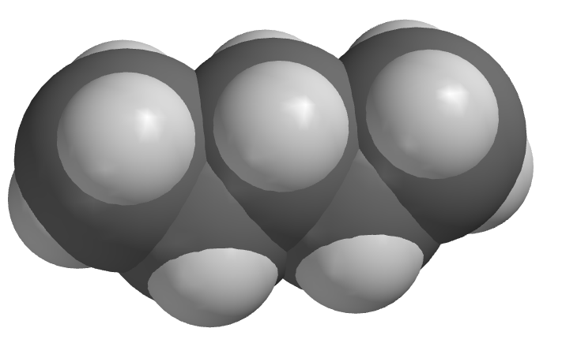
Week 2
Give chemical names of two of these hydrocarbons

Slide 10
Week 2
Calculate the approximate molecular weight of H₂O, and specify the units of your answer

Slide 11
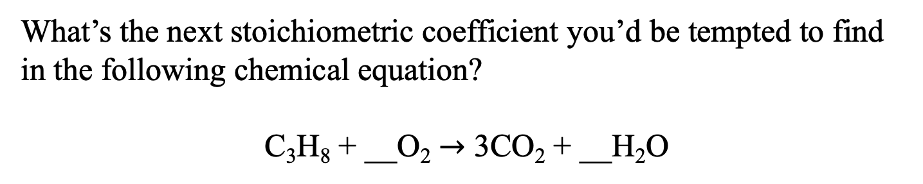
Week 2
What’s the next stoichiometric coefficient you’d be tempted to find in the following chemical equation?
C₃H₈ + __O₂ $→$ 3CO₂ + __H₂O

Slide 12
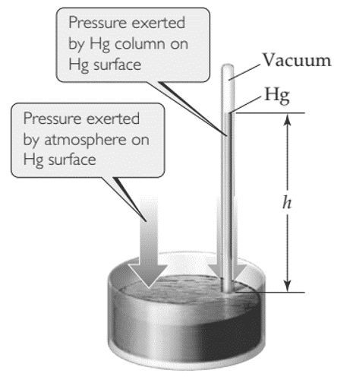
Week 3
Suppose the height (h) of a mercury barometer is 77 cm. What’s the pressure in atm?

Slide 13
Week 3
In a spreadsheet, show how to enter the number 6.02×10²³ in a spreadsheet using the “E” notation method

Slide 14
Week 3
Use a spreadsheet to compute the number of moles in a 350-mL container at ordinary temperature and pressure

Slide 15
Week 3
State the charges you’d expect on each of the following ions
Carbonate
(anion)
Bicarbonate
(anion)
Calcium
(as a cation)
Sodium
(as a cation)

Slide 16
Week 3
Carbonate
(anion)
-2
Bicarbonate
(anion)
-1
Calcium
(as a cation)
+2
Sodium
(as a cation)
+1
Write the chemical formulas for the following salts
Calcium bicarbonate:
Sodium carbonate:

Slide 17
Week 3
Using Spartan, construct and interpret an electrostatic potential map of H₂O

Slide 18
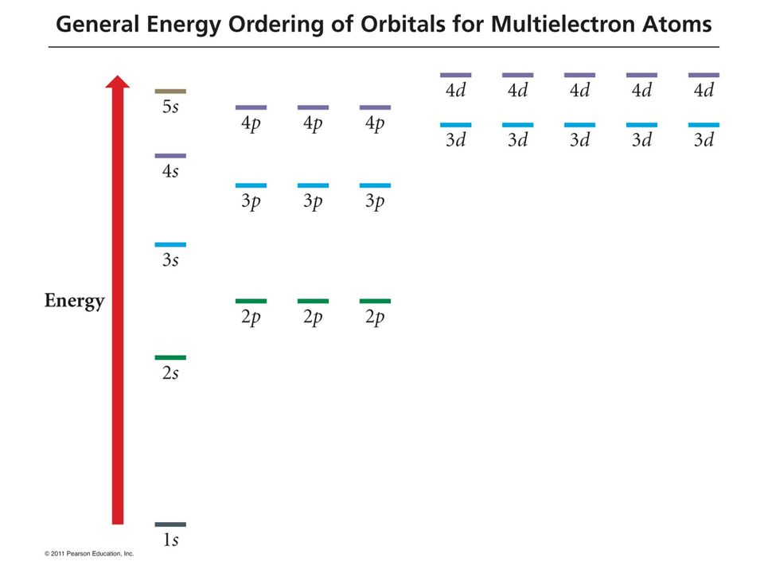
Week 4
Write the electron configuration of Beryllium (Be)

Slide 19
Week 4
Write the electron configuration of Boron (B)

Slide 20
Week 4
Write the electron configuration of Carbon (C)

Slide 21
Week 4
Use Spartan to determine if a visible photon is likely to be emitted by Na⁺ after it is excited to 1s²2s²2p⁵3p¹

